Slide 1
3.3Energy Resources
Human population, carrying capacity and resource use

Slide 2
Types of energy resources
Renewable and non-renewable
Energy mix – combination of renewable and non-renewable resources

Slide 3
Types of energy resources – examples of non-renewable
Oil
Natural gas
Coal
Nuclear energy

Slide 4
Domination of Non-renewable resources
Fossil fuels are by far the largest energy source human use: these make up 85% of the worlds energy use;
34-37% as Oil
25% as Coal
20-23% as Natural Gas
6% Uranium (Nuclear Energy) – also a non-renewable.

Slide 5
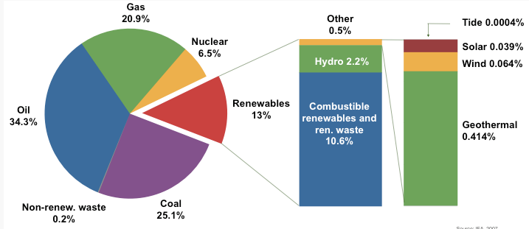
Utilization of energy resources

Slide 6
Oil
Contributes 27.7% (Asia Pacific)
Main source of energy in North, South & Central America, Europe & Eurasia, Middle East & Africa.
Middle east accounts – 51%

Slide 7
Coal
Fossilized plants mined by open cast mining or long tunnels. Burnt to provide heat, or to create electricity by turning turbines in power stations
Advantages: Plentiful supply (should last another 250 years more). Easy to transport as a solid. No processing required. Relatively cheap to mine and convert to energy.
Disadvantages: Cannot be replaced once used (non-renewable). Burning releases carbon dioxide which is a greenhouse gas.
contain 10% sulphur which can form sulphur dioxide and acid rain.
Particles of soot from burning coal can cause SMOG (pollution in cities) and lung disease. Coal mines lead to degraded (damage) land and pollution.
Lower heat of combustion than other fossil fuels (less energy released per mass)

Slide 8
NATURAL GAS
Methane gas and other hydrocarbons trapped in the rock. Extracted by drilling. Often found with crude oil. Used directly in homes for heating and cooking.
Advantages: Highest heat of consumption. Lots of energy gained from it. Ready made fuel, no processing required. Relatively cheap form of energy. Cleaner than coal or oil.
Disadvantages: Only a limited supply of gas with an estimated 70 years remaining. Also gives of carbon dioxide but only half of the produced by coal

Slide 9
Nuclear Energy
Forms smallest contribution in Asia, Pacific, Africa and South & Central America.
Important in Europe, Eurasia and North America.

Slide 10
Renewable energy
Hydro electricity
Wind energy
Bio-fuels
Solar power
Geothermal energy
Tidal energy
Fuel Wood
15% comes from renewable energy sources

Slide 11
Renewable Energy – Hydroelectricity
Big four HEP nations
  China, Canada, Brazil and USA
  Forms 50% of the global consumption
  HEP locations – large scale development
  Small scale HEP plants in developing countries – to supply local communities

Slide 12
HYDROELECTRIC POWER
Energy harnessed from the movement water through rivers, lakes and dams to power turbines to generate electricity.
High-quality energy output compared to low-quality energy output. Creates water reserves as well as energy supplies. Reservoirs can also be used for recreation. Safety record is good.
Costly to build. Can cause the flooding of surrounding communities and landscapes. Dams have a major impact on local Hydrology. Downstream lack of water. Risk of flooding if dam bursts

Slide 13
WIND
Wind turbines turn wind energy into electricity. Usually found as many together in ´wind farms`.
Clean supply of energy once turbines are made. Little maintenance required.
Need the wind to blow. Often windy sites are not near populated areas. Manufacture of wind farms can be costly. Noise pollution. Some local people complain that it spoils the countryside. Maybe some birds are killed by turbines.

Slide 14
WIND
World wide capacity of wind energy – 200 000 MW
Global wind report – 2010 estimates reports doubling in 3-4 yrs.
Dominated only in small no. of countries
China – 22.7% of global capacity
Repowering play important role for longevity
New developments

Slide 15
SOLAR
Conversion of solar radiation into electrical energy via chemical energy.
Potentially infinite energy supply. Single dwellings can have their own electricity supply. Safe to use. Low quality energy converted to high.
Manufacture and implementation of solar panels can be costly. Need sunshine, do not work in the dark.

Slide 16
Geothermal Energy
Natural heat found in the Earth’s crust in the form of steam, hot water and hot rock.
Heat due to GEOTHERMAL GRADIENT : rate at which temperature rises as depth below the surface increases.
Avg. rise in temperature ~30⁰C per km, the gradient can reach ~80⁰C near plate boundaries

Slide 17
Tidal Power
Acts like underwater wind mills, transforming sea currents into electrical current.
More predictable than solar or wind.
Infrastructure is less obstructive, but start up costs are high.
240 MV rance facility in North-West France
Ex: Canada’s Bay or Fundy in Nova Scotia

Slide 18
Fuel Wood
~ 2.5 billion people rely on Fuel wood, Charcoal and animal dung for cooking.
Fuel wood and charcoal are collectively called fuel wood.
Fuel wood used much in Sub-Saharan Africa, Asia.

Slide 19
Factors affecting – Non renewable resources - OIL
Rapidly rising Oil cost – fluctuation
Concentrated in Middle East, political instability for import
Reserves: Production ratio different in countries having reserves.
Natural disasters – hurricanes in US, Gulf of Mexico
Peak oil production (2013-2037) followed by 3% fall every year.
Geopolitics, Strategic petroleum reserves (SPR)
Revolts

Slide 20
Factors affecting choice of energy resources
Choice of energy changed over time due to:
Technological developments to use other forms of energy
Increasing national wealth
Changes in demand
Changes in price – fluctuation & instability
Environmental factors/public opinion
Physical, Economic, technical, political and cultural reasons

